Slide 1


TWITTER SENTIMENT ANALYSIS
Presented by:
Keivan Mokhtarpour
Aug. 27th, 2021

Slide 2
AGENDA
BIG PICTURE
METHODOLOGY (AWS TOOLS)
DATA PREPROCESSING AND ML IN DATABRICKS
AMAZON ATHENA (SQL)
QUICKSIGHT DASHBOARD
Q&A

Slide 3














Twitter Sentiment Analysis
Twitter
AWS
Databricks
Taliban take over Afghanistan ☹
Data Pipeline in Cloud
1
2
4
5
6
3
7
8
Number of Tweets Stored in Amazon S3
Time Domain of Tweets Stores in Amazon S3
~2M
Tue. 24th ~ Thu. 26th

Slide 4
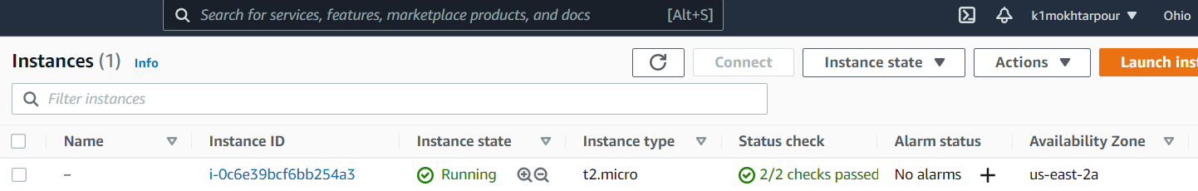
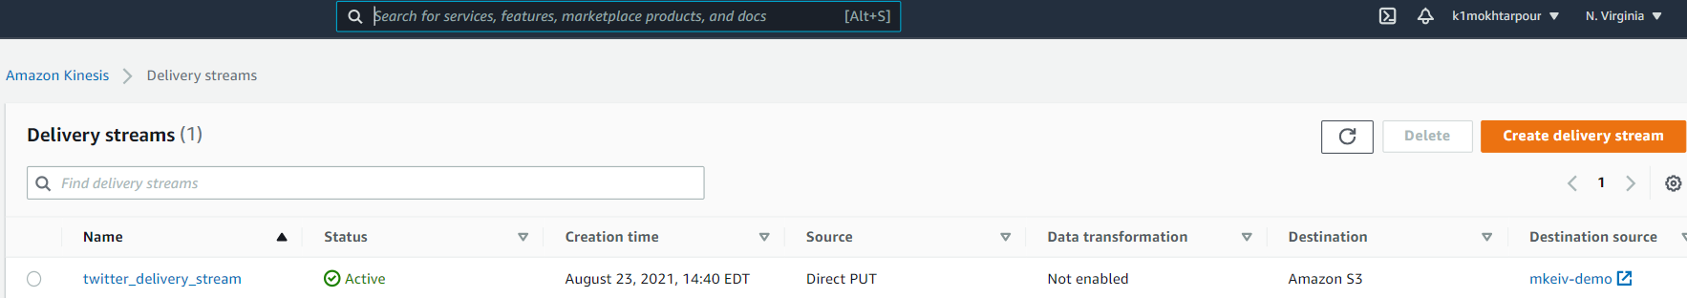
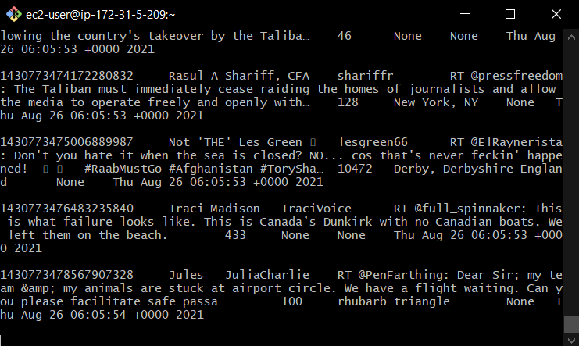
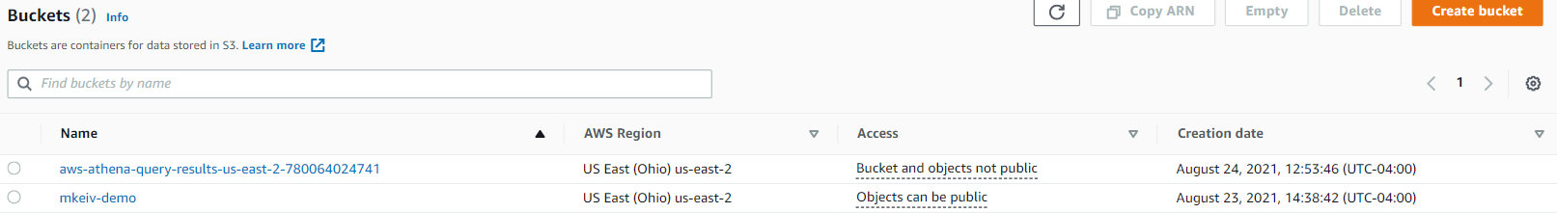
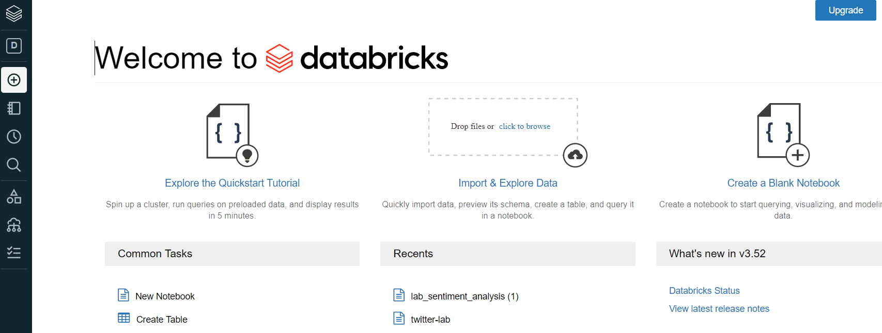
Introduction
2
4
AWS EC2
Data Streaming in Kinesis Firehose
3
Scraping Tweets in Terminal
5
Data Storing in Amazon S3
6
Data Processing and ML in Databricks

Slide 5
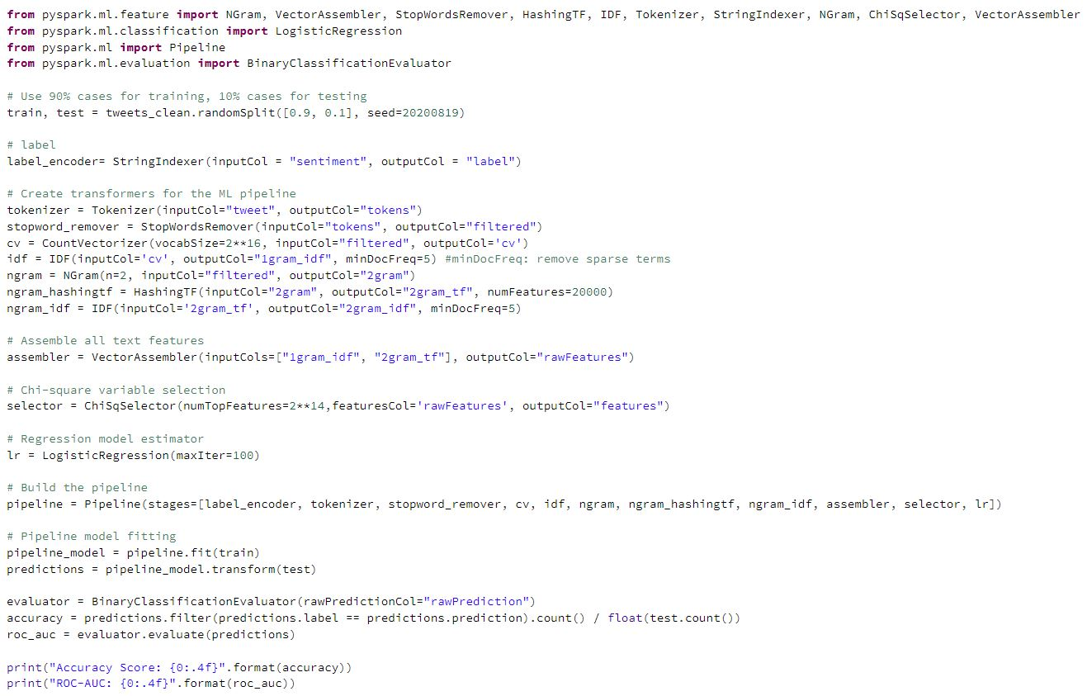
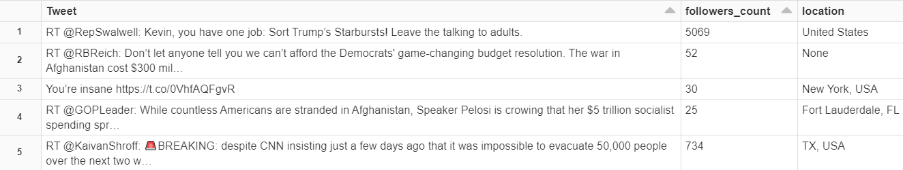
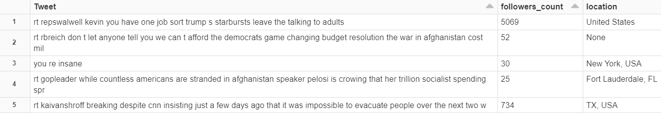

Data Processing and ML in Databricks
Connecting to Amazon S3 and mounting the bucket
Tweet cleaning preprocessing
Loading the trained ML model
`pyspark.sql.functions.regexp_replace` is used to process the text
1. Removing URLs 2. Removing special characters 3. Substituting multiple spaces with single space 4. Lowercase all text 5. Trim the leading/trailing whitespaces 6. Removing RT 7. Removing User_id
Sentiment Prediction on the cleaned dataset
Saving the dataset in Amazon S3

Slide 6
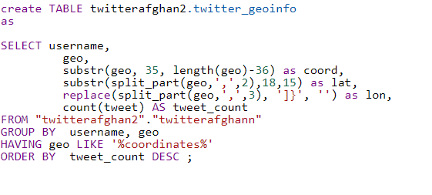
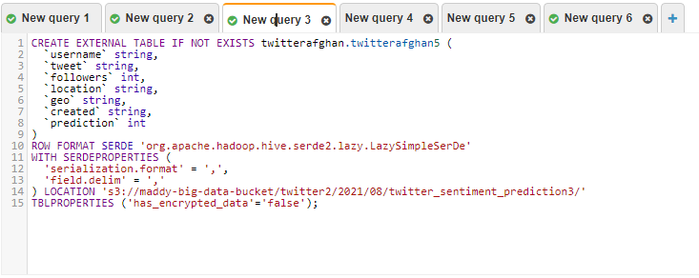
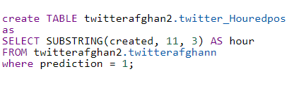
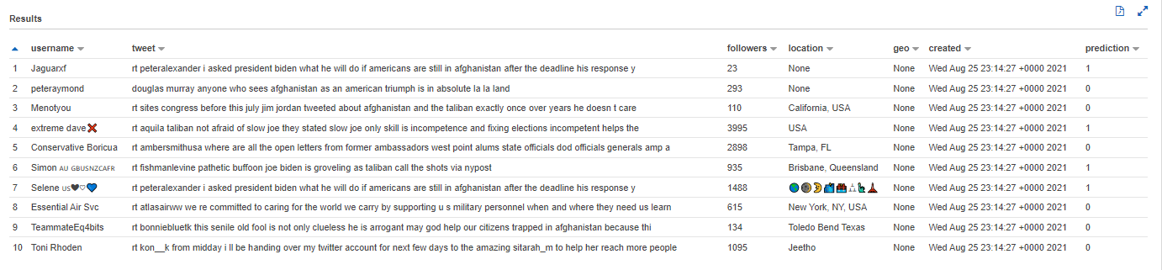
Amazon Athena
Use Athena to Create Tables
Final Dataset

Slide 7
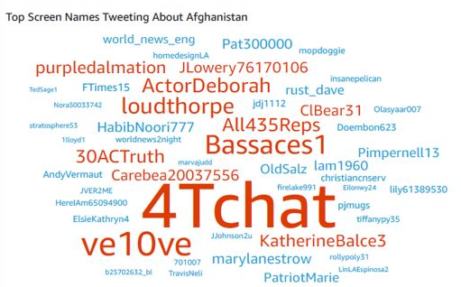
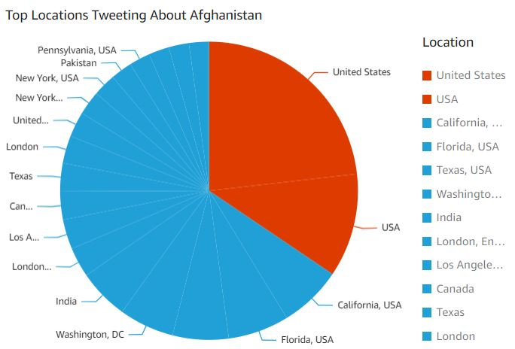

QuickSight Dashboard
Screen Names
Locations

Slide 8
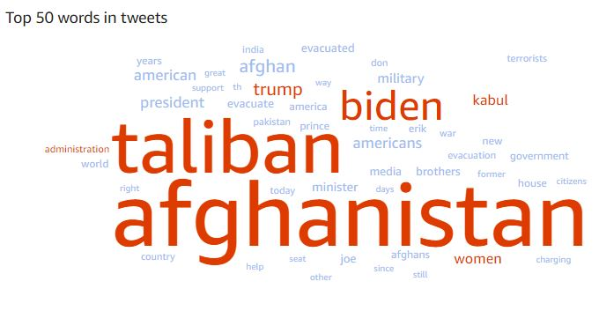
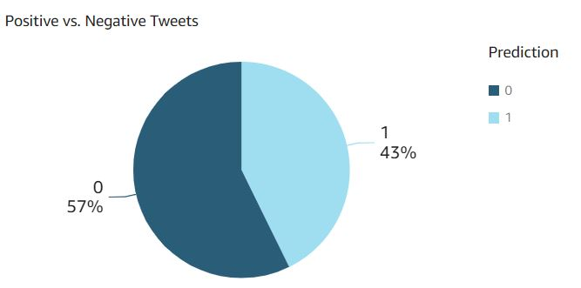
QuickSight Dashboard
Tweets

Slide 9
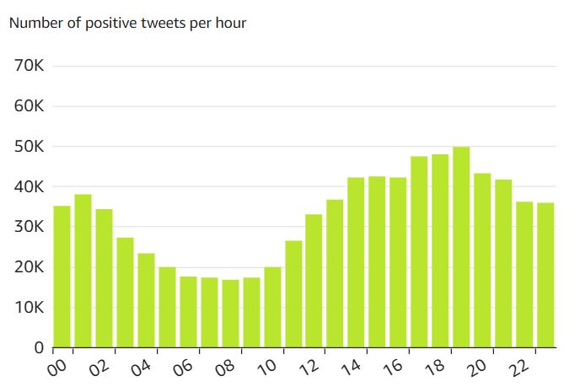
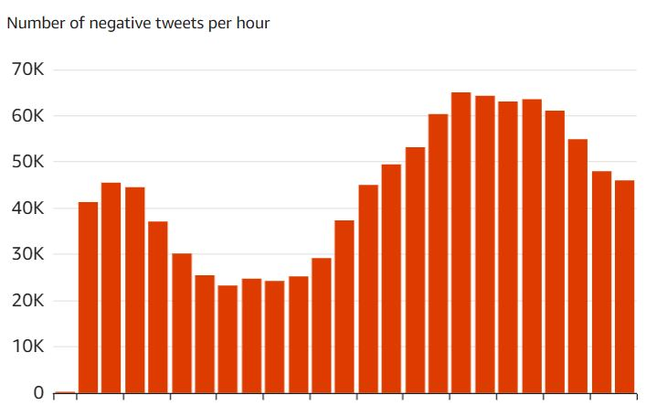
QuickSight Dashboard
Prediction vs. Hour

Slide 10
Q&A
Thanks For Your Attention

